Slide 1
Sampling
Dr. Basharat Mahmood
Assistant Professor, Department of Computer Science, COMSATS University Islamabad, Pakistan.

Slide 2
1. Introduction
Statistics- is the science of data
a systematic collection of numerical facts
Statistics is a branch of applied mathematics that involves the collection, description, analysis, and inference of conclusions from quantitative data
Data- data are individual pieces of factual-information recorded and used for the purpose of analysis
It is the raw information from which statistics are created
Data is used to create new information or knowledge
For example, census data provides data about the number of people within a particular area with variables such as gender, age, income, etc.

Slide 3
1. Introduction…
Statistical Methods- Statistical methods are mathematical formulas, models, and techniques that are used in statistical analysis of raw research data.
Descriptive Statistic- A descriptive statistic is a summary statistic that quantitatively describes or summarizes features of a collection of information
descriptive statistics is the process of using and analysing those statistics.
Inferential Statistics- is the process of using data analysis to infer properties of a population

Slide 4
1. Introduction…
Population vs. Sample- A population is the entire group that you want to draw conclusions about while a sample is the specific group that you will collect data from
size of the sample is always less than the total size of the population
Parameter vs. Statistic- A parameter is a number describing a whole population (e.g., population mean), while a statistic is a number describing a sample (e.g., sample mean)

Slide 5
1. Introduction…
Sampling- selecting the group that you will actually-collect data from in your research
Simple Random Sample – A sample designed in such a way as to ensure that (1) every member of the population has an equal chance of being chosen and (2) every combination of N members has an equal chance of being chosen.

Slide 6
1. Introduction…
Sampling Techniques
Probability Sampling Techniques: In probability sampling, each member of the population has a known and non-zero chance of being selected.
Non-Probability Sampling Techniques: In non-probability sampling, not all individuals have a known or equal chance of being selected. This approach is often more practical but can lead to bias.

Slide 7
1. Introduction…
Probability Sampling Techniques
Simple Random Sampling: every single member of a population is chosen randomly, merely by chance.
everyone has the same probability of being chosen to be a part of a sample.
Systematic Sampling: Systematic random sampling – A method of sampling in which every Kth member in the total population is chosen for inclusion in the sample after the first member of the sample is selected at random from among the first K members of the population.

Slide 8
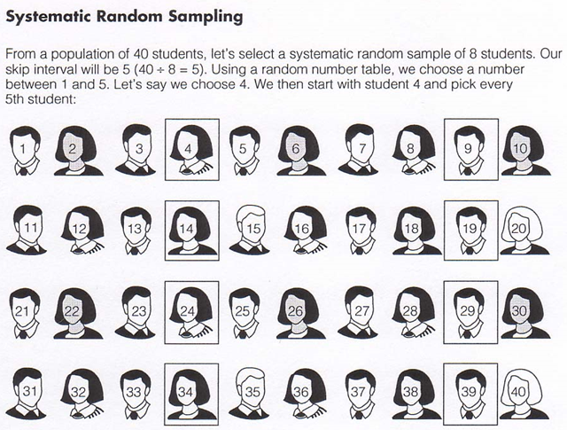
1. Introduction…

Slide 9
1. Introduction…
Stratified Sampling- A method of sampling obtained by (1) dividing the population into subgroups based on one or more variables central to our analysis and (2) then drawing a simple random sample from each of the subgroups
Proportionate stratified sample – The size of the sample selected from each subgroup is proportional to the size of that subgroup in the entire population. (Self-weighting)
Disproportionate stratified sample – The size of the sample selected from each subgroup is disproportional to the size of that subgroup in the population. (needs weights)

Slide 10
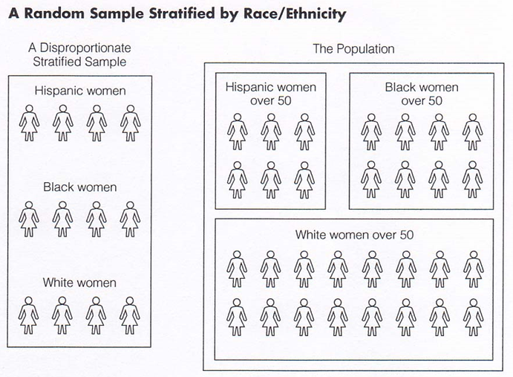
1. Introduction…

Slide 11
1. Introduction…
Cluster Sampling- sampling technique where researchers divide the population into multiple groups (clusters) for research. So researchers then select random groups with a simple random or systematic random sampling technique for data collection and analysis.

Slide 12
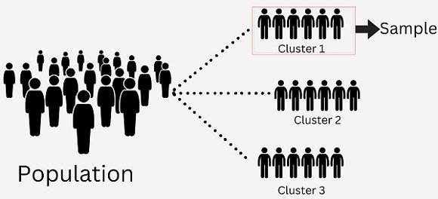
1. Introduction…

Slide 13
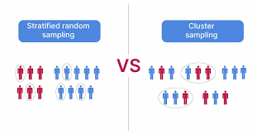
1. Introduction…
Cluster vs. Stratified Sampling

Slide 14
1. Introduction…
Non-probability Sampling Techniques
Convenience Sampling: Samples are taken from a group that is easily accessible. For example, a researcher might survey friends or colleagues rather than a random selection from the entire population.
Judgmental Sampling (Purposive Sampling): The researcher uses their judgment to select individuals who are thought to be representative or particularly informative about the research topic. This is common in qualitative research.
Snowball Sampling: Existing study subjects recruit future subjects from among their acquaintances. This technique is particularly useful for reaching populations that are hard to access or identify, such as specific subcultures.

Slide 15
1. Introduction…
Non-probability Sampling Techniques
Quota Sampling: The researcher ensures equal representation of various subgroups within the sample by setting quotas. For instance, if a researcher wants to ensure that 50% of participants are women and 50% are men, they will continue sampling until these quotas are met, regardless of the overall population proportion.
Self-Selection Sampling: Individuals volunteer to participate in the study, such as through online surveys. This can lead to a bias since those who choose to participate may have different characteristics or opinions than those who do not.

Slide 16
1. Introduction…
Probability Sampling vs. Non-probability Sampling
Generalizability: Probability sampling typically allows for high generalizability of results, meaning findings can be applied to the larger population. Non-probability sampling has limited generalizability; results may not represent the broader population effectively.
Bias: Probability sampling reduces the risk of selection bias, as the process is random and minimizes researcher influence. Non-probability sampling has a higher potential for bias, as selection can be influenced by the researcher’s choices or by the participants' networks.
Statistical Validity: Probability sampling supports statistical analysis and allows for the calculation of sampling error, enhancing the reliability of the findings. Non-probability sampling has limited statistical validity and may not support rigorous analysis.

Slide 17
1. Introduction…
Probability Sampling vs. Non-probability Sampling
Cost and Time: Probability sampling is generally more costly and time-consuming due to the structured methods required for random selection. Non-probability sampling is usually quicker and cheaper, making it easier to implement in exploratory research.
Use Cases: Probability sampling is suitable for quantitative research aiming for a representative sample. Non-probability sampling is often used in qualitative research, exploratory studies, or when studying hard-to-reach populations.
Flexibility: Probability sampling is less flexible, requiring structured methods for selection. Non-probability sampling allows for more tailored approaches based on specific research needs.

Slide 18
1. Introduction …
Characteristics of a Good Sample
Representativeness: The sample should accurately reflect the characteristics of the larger population. This includes demographics, behaviours, and other relevant attributes.
Size: The sample size should be large enough to provide sufficient data for analysis, ensuring that the results are statistically significant. Larger samples generally reduce the margin of error.
Randomness: A good sample should be selected randomly to minimize bias. Random selection helps ensure that every individual has an equal chance of being included, enhancing the sample's representativeness.
Diversity: The sample should include a variety of participants to capture different perspectives and experiences. This diversity can enhance the richness of the data and improve generalizability.

Slide 19
1. Introduction …
Characteristics of a Good Sample
Consistency: The sampling method should be applied consistently across all participants. This consistency helps ensure that the sample is not inadvertently skewed by varying selection criteria.
Accessibility: The sample should be feasible to reach and engage with. Consideration of accessibility ensures that the research can be conducted within practical constraints.
Clarity of Inclusion Criteria: Clearly defined criteria for who is included in the sample help maintain focus and ensure that the sample is relevant to the research question.
Ethical Considerations: The sampling process should adhere to ethical standards, including obtaining informed consent and ensuring the privacy and confidentiality of participants.
Ability to Analyse: The data collected from the sample should be agreeable to analysis using the chosen research methods. This means the sample should provide the type of data necessary for addressing the research questions.

Slide 20
2. Sampling Distribution
A sampling distribution is a probability distribution of a statistic obtained from a larger number of samples drawn from a specific population
The sampling distribution of a given population is the distribution of frequencies of a range of different outcomes that could possibly occur for a statistic of a population
Its primary purpose is to establish representative results of small samples of a comparatively larger population

Slide 21
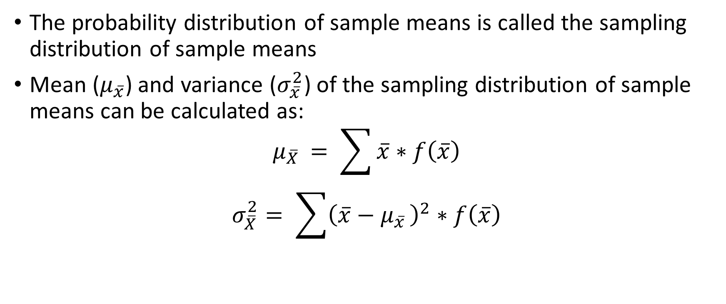
2.1 Sampling Distribution of the Sample Means
The probability distribution of sample means is called the sampling distribution of sample means
Mean ($μ_{\overline{x}}$) and variance ($σ_{\overline{x}}^{2}$) of the sampling distribution of sample means can be calculated as:
$$μ_{\overline{X} }= \sum{\overline{x}∗f\left(\overline{x}\right)}$$
$$σ_{\overline{X}}^{2}= \sum{{\left(\overline{x}−μ_{\overline{x} }\right)}^{2}∗f\left(\overline{x}\right)}$$

Slide 22
2.1 Sampling Distribution of the Sample Means
Example 1: Given the population 1, 2, 3 and 4. Draw all possible samples of size 2 with replacement and without replacement; and draw a sampling distribution of sample means. Also find the mean and variance of the sampling distribution of sample mean.

Slide 23
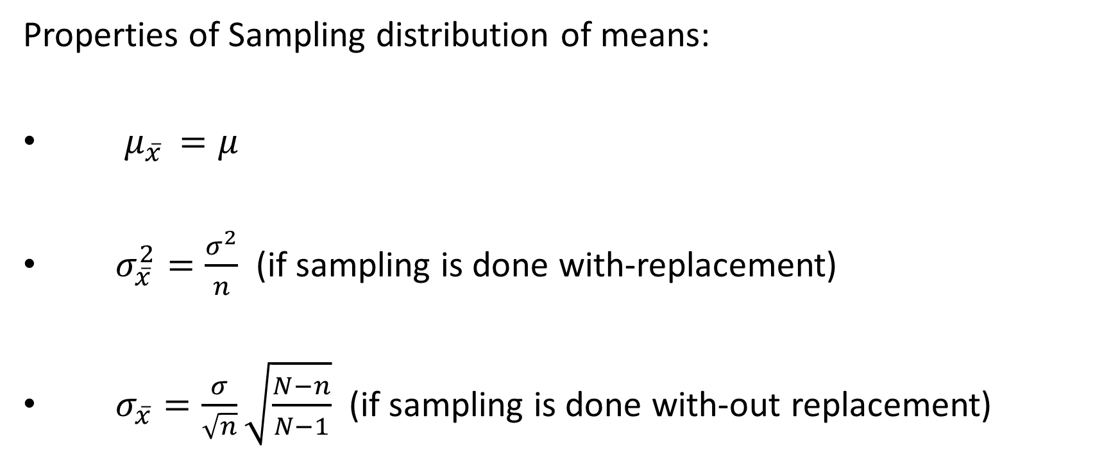
2.1 Sampling Distribution of the Sample Means
Properties of Sampling distribution of means:
$μ_{\overline{x} }=μ$
$σ_{\overline{x}}^{2}=\frac{σ^{2}}{n}$ (if sampling is done with-replacement)
$σ_{\overline{x}}=\frac{σ}{\sqrt{n}}\sqrt{\frac{N−n}{N−1}}$ (if sampling is done with-out replacement)

Slide 24
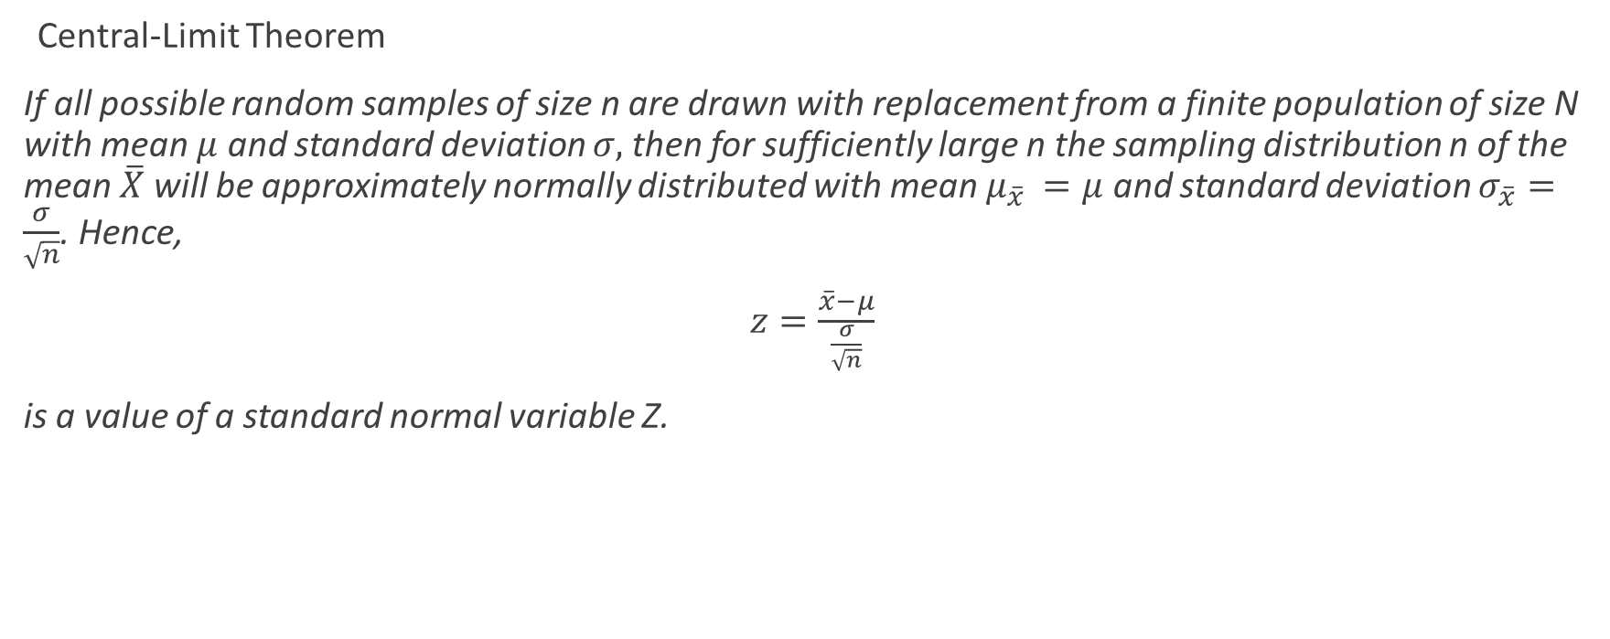
2.1 Sampling Distribution of the Sample Means
Central-Limit Theorem
If all possible random samples of size n are drawn with replacement from a finite population of size N with mean $μ$ and standard deviation $σ,$then for sufficiently large n the sampling distribution n of the mean $\overline{X}$will be approximately normally distributed with mean $μ_{\overline{x} }=μ$ and standard deviation $σ_{\overline{x}}=\frac{σ}{\sqrt{n}}$. Hence,
$z=\frac{\overline{x}−μ}{\frac{σ}{\sqrt{n}}}$
is a value of a standard normal variable Z.

Slide 25
2.1 Sampling Distribution of the Sample Means
Example No. 2: Given the population 1, 1, 1, 3, 4, 5, 6, 6, 6, and 7, find the probability that a random sample of size 36, selected with replacement will yield a sample mean greater than 3.85 but less than 4.5 if the mean is measured to the nearest tenth.

Slide 26
2.1 Sampling Distribution of the Sample Means

Slide 27
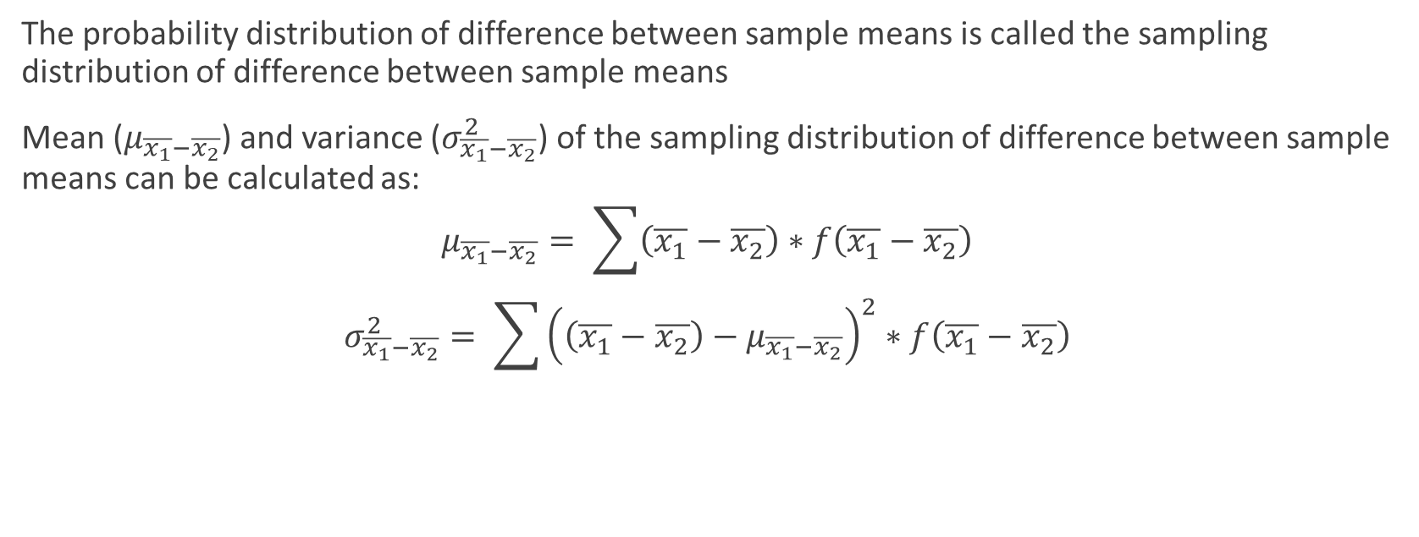
2.2 Sampling Distribution of difference between Two Sample Means
The probability distribution of difference between sample means is called the sampling distribution of difference between sample means
Mean ($μ_{\overline{x_{1}}−\overline{x_{2}}}$) and variance ($σ_{\overline{x_{1}}−\overline{x_{2}}}^{2}$) of the sampling distribution of difference between sample means can be calculated as:
$$μ_{\overline{x_{1}}−\overline{x_{2}}}= \sum{\left(\overline{x_{1}}−\overline{x_{2}}\right)∗f\left(\overline{x_{1}}−\overline{x_{2}}\right)}$$
$$σ_{\overline{x_{1}}−\overline{x_{2}}}^{2}= \sum{{\left(\left(\overline{x_{1}}−\overline{x_{2}}\right)−μ_{\overline{x_{1}}−\overline{x_{2}}}\right)}^{2}∗f\left(\overline{x_{1}}−\overline{x_{2}}\right)}$$

Slide 28
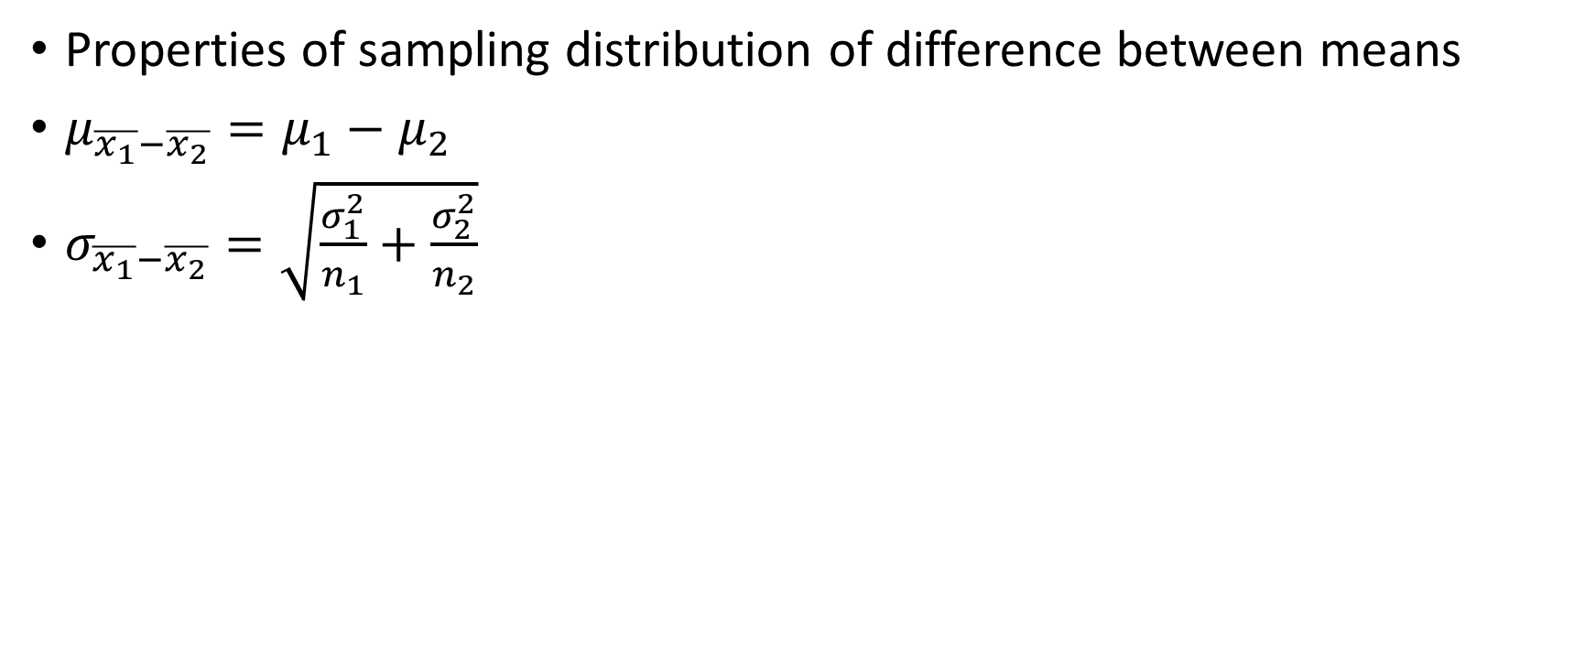
2.2 Sampling Distribution of difference between Two Sample Means
Properties of sampling distribution of difference between means
$μ_{\overline{x_{1}}−\overline{x_{2}}}=μ_{1}−μ_{2}$
$σ_{\overline{x_{1}}−\overline{x_{2}}}=\sqrt{\frac{σ_{1}^{2}}{n_{1}}+\frac{σ_{2}^{2}}{n_{2}}}$

Slide 29
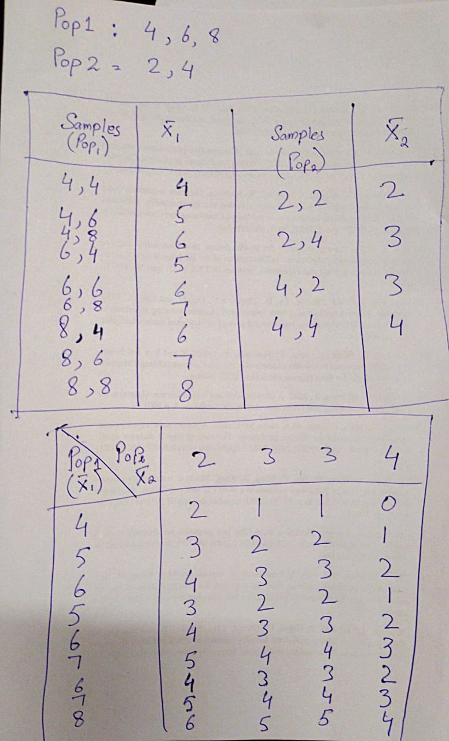
2.2 Sampling Distribution of difference between Two Sample Means

Slide 30
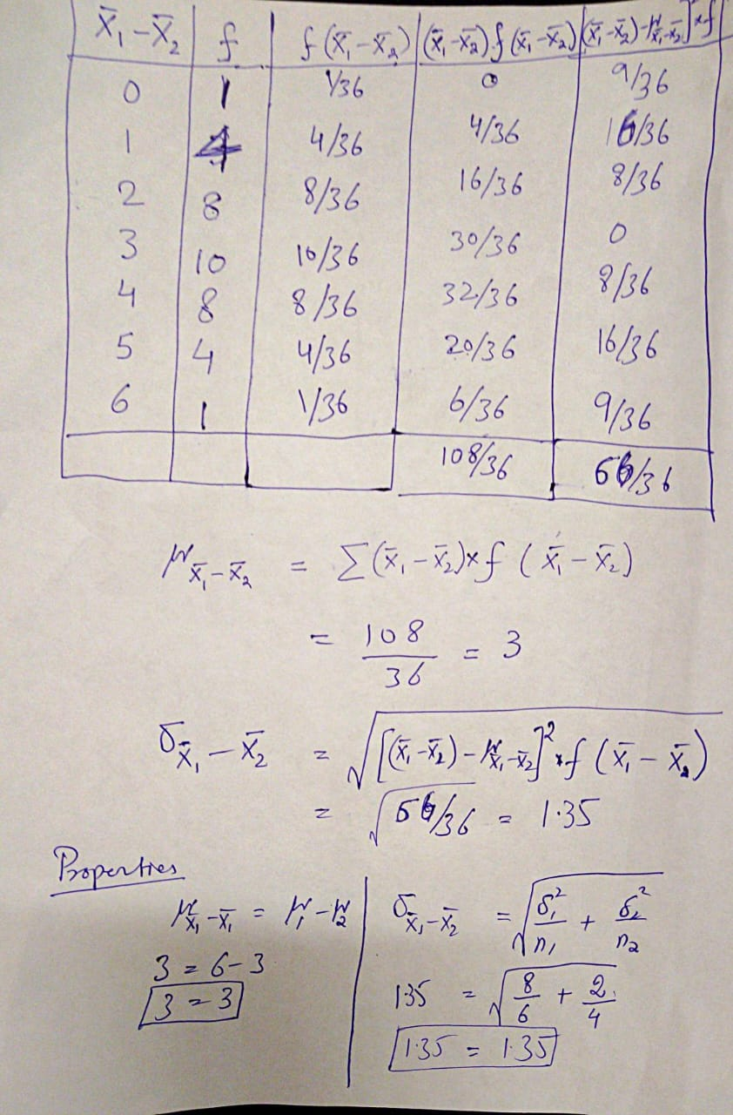
2.2 Sampling Distribution of difference between Two Sample Means

Slide 31
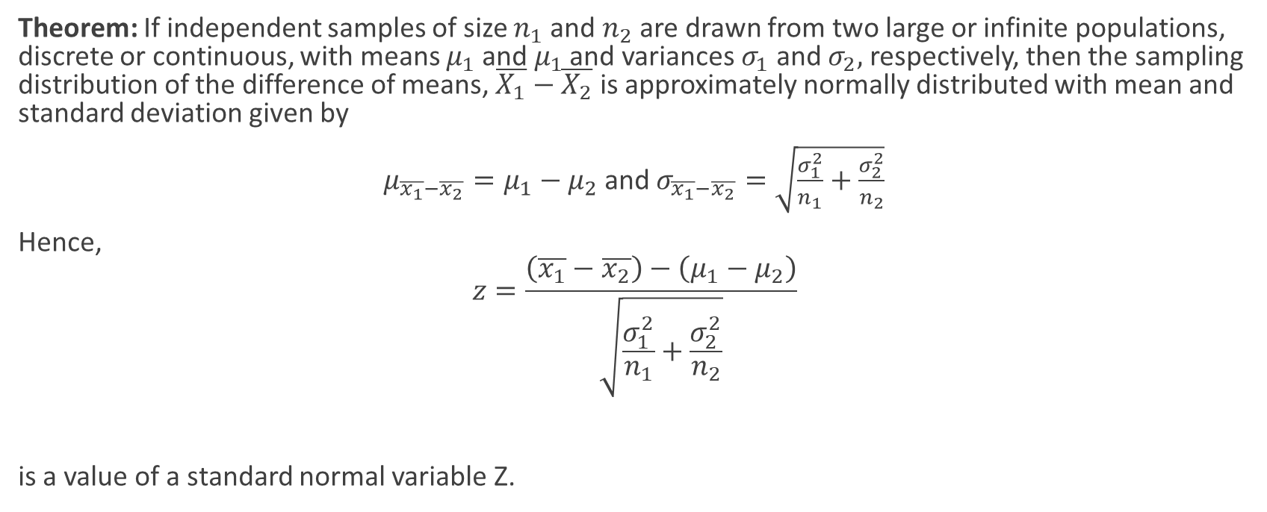
2.2 Sampling Distribution of difference between sample means
Theorem: If independent samples of size $n_{1}$ and $n_{2}$ are drawn from two large or infinite populations, discrete or continuous, with means $μ_{1}$ and $μ_{1}$ and variances $σ_{1}$ and $σ_{2},$ respectively, then the sampling distribution of the difference of means, $\overline{X_{1}}−\overline{X_{2}}$ is approximately normally distributed with mean and standard deviation given by
$μ_{\overline{x_{1}}−\overline{x_{2}}}=μ_{1}−μ_{2}$ and $σ_{\overline{x_{1}}−\overline{x_{2}}}=\sqrt{\frac{σ_{1}^{2}}{n_{1}}+\frac{σ_{2}^{2}}{n_{2}}}$
Hence,
$$z=\frac{\left(\overline{x_{1}}−\overline{x_{2}}\right)−\left(μ_{1}−μ_{2}\right)}{\sqrt{\frac{σ_{1}^{2}}{n_{1}}+\frac{σ_{2}^{2}}{n_{2}}}}$$
is a value of a standard normal variable Z.

Slide 32

2.1 2.1 Sampling Distribution of difference between Two Sample Means
Example No. 3: A sample of size $n_{1}$=5 is drawn at random from a population that is normally distributed with mean $μ_{1}=50$ and variance $σ_{1}^{2}=9$, and the sample mean is recorded. A second sample of size $n_{2}=4$ is selected, independent of the first sample, from a different population that is also normally distributed with mean $μ_{2}=40$ and variance $σ_{2}^{2}=4,$ and the sample mean is recorded. What is the $P\left(\overline{X_{1}}−\overline{X_{2}}<8.2\right)?$

Slide 33
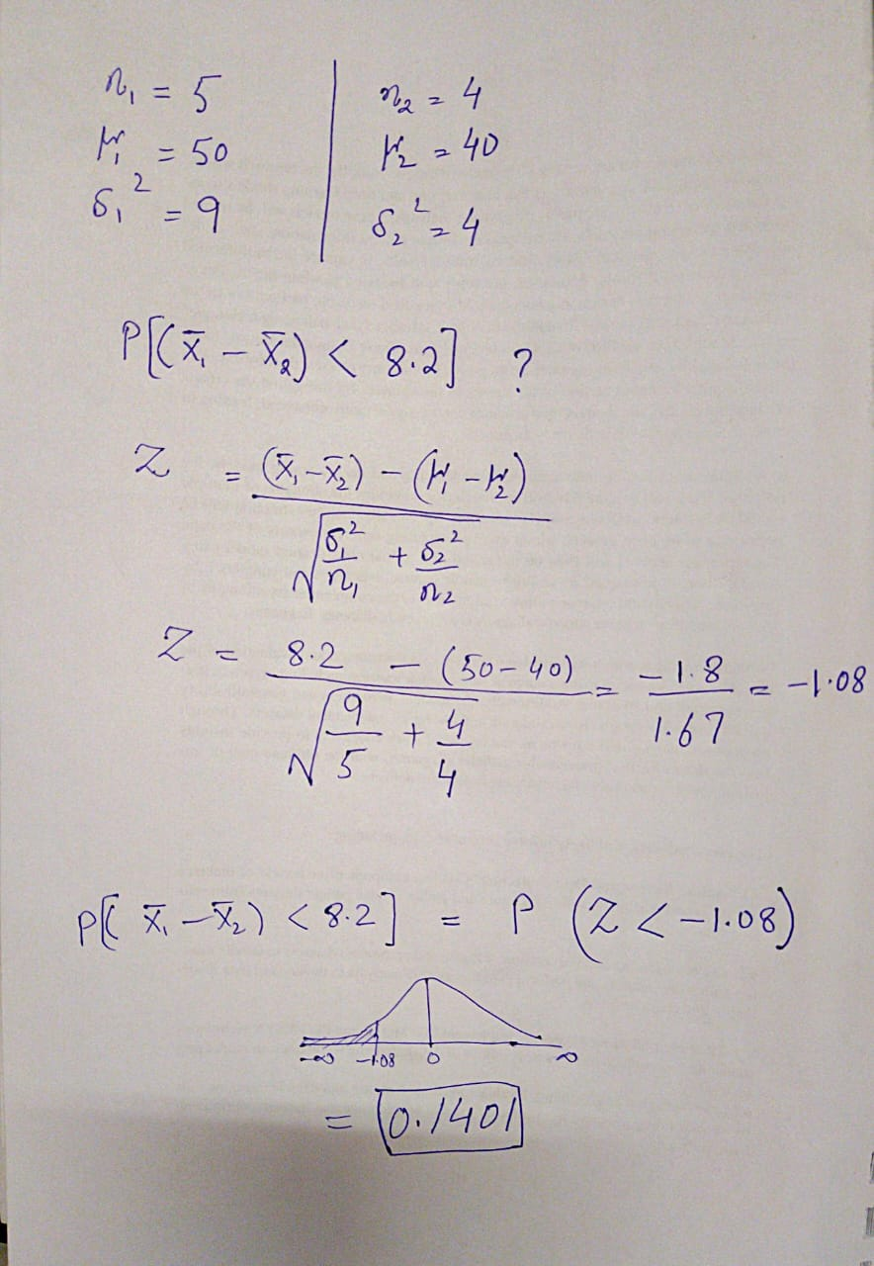
2.2 Sampling Distribution of difference between Two Sample Means

Slide 34
The End

